Slide 1
Blood, Lymphatics and Immune System
Krishna Bastola
B.Sc. MLT, M.Sc.

Slide 2
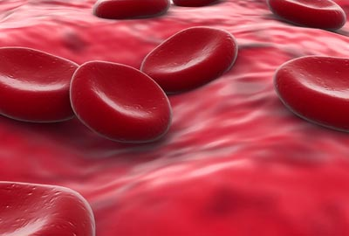
Anemia
Reduction in the number of circulating red cells (red cell mass) below a normal range for the age and sex of the individual, which leads to the significant decrease in the hemoglobin.

Slide 3
Anemia
As a result, the amount of the oxygen delivered to the body tissues is also diminished.
Anemia is not the specific disease state but a sign of the underlying disorder
It is the most common hemolytic condition
It is also defined as a reduction below in the volume of packed red cells, as measured by the hematocrit, or a reduction in the hemoglobin concentration of the blood.

Slide 4
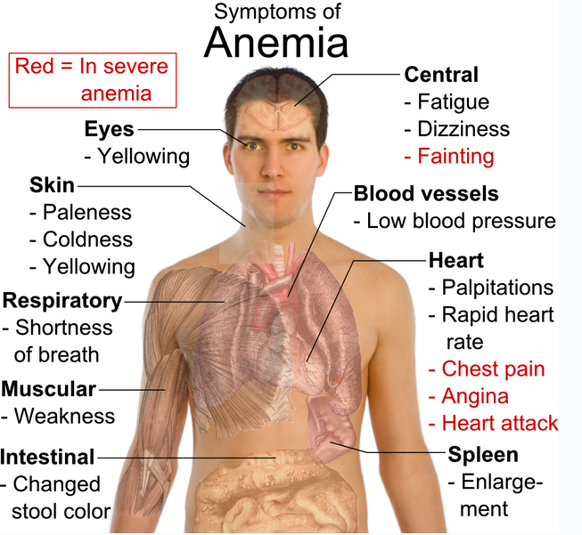
Anemia

Slide 5
Anemia
Classification:
Hemolytic anemia: destruction of RBCs
Iron-deficiency anemia (microlytic anemia): iron deficiency leads to inadequate hemoglobin synthesis
Megaloblastic anemia (macrolytic anemia): abnormally large cells, defect in DNA, RNA and Protein synthesis, leads to defective cell maturation and division
Pernicious anemia (macrolytic anemia): vitamin B12 deficiency
Folic acid deficiency anemia (normolytic anemia): interferes new red cells formation
Sickle cell anemia: structurally abnormal hemoglobin

Slide 6
Anemia
Anemia
Morphological Classification
Patho-physiological Classification
Blood loss
Normochromic normocytic
MCV-N, MCH-N, MCHC-N
Increased rate of destruction
Hypochromic microcytic
MCV- L , MCH-L, MCHC-L
Impaired red cell production
Macrocytic normochromic
MCV- H , MCH-H, MCHC-N
Microcytic normochromic
MCV= Mean Corpuscular volume (75-100 fl)
MCH= Mean Cell Hemoglobin (27-32 pg)
MCHC= Mean Cell Hemoglobin Concentration (32-37 g/dl)
MCV- SL , MCH-SL, MCHC-N

Slide 7
Anemia
Iron deficiency anemia (IDA)

Slide 8
Anemia
Iron deficiency anemia (IDA)
The condition in which there is anemia and clear evidence of iron deficiency.
Deficiency of iron is probably the most common nutritional disorder in the world.
The prevalence of IDA is higher in the developing countries in toddlers, adolescent girls, and women of childbearing age.
It typically results when the intake of dietary iron is inadequate for hemoglobin synthesis.
The most common cause of this anemia in men and postmenopausal women is bleeding from ulcers, gastritis, inflammatory bowel disease or GI tumor.

Slide 9
Anemia
Iron deficiency anemia (IDA)
Iron metabolism:
The total body iron content is normally in the range of 2 gm in women and up to 6 gm in men.
It is divided into function and storage compartments. Approximately 80% of the functional iron is found in hemoglobin, myoglobin and iron containing enzymes.
Storage of iron is represented by Ferritin and Homosiderin.
Ferritin is essentially a protein-iron complex that can be found in all tissues but particularly in liver, spleen, bone marrow and skeletal muscles.

Slide 10
Anemia
Iron deficiency anemia (IDA)
Causes:
Increased demand for iron/or hematopoiesis
Rapid growth in infancy or adolescence
Pregnancy
Erythropoietin therapy
Increased iron loss
Chronic blood loss
Menses
Blood donation
Phlebotomy as treatment for polycythemia vera
Decreased iron intake or absorption
Inadequate diet
Malabsorption from disease (sprue, Crohn’s disease)
Malabsorption surgery (post-gastrectomy)

Slide 11
Anemia
Iron deficiency anemia (IDA)
Clinical manifestation:
Dry, pale skin
Blue sclera
Glossitis (swollen red tongue) , Stomatitis (Inflammation or ulceration of the mouth)
Dysphagia (Difficulty in swallowing)
Dyspnea (Difficulty in breathing)
Gastritis
Spoon shaped nails (Koilonychia)
Angina (suffocation)
Hair loss
Constipation
Splenomegaly
Increased platelet count
Hypochromic, microcytic RBCs

Slide 12
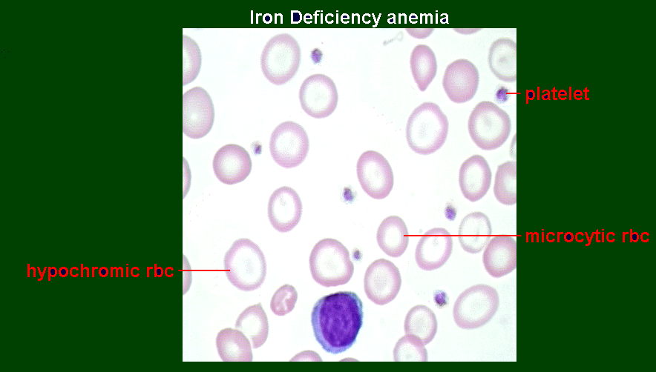
Anemia
Iron deficiency anemia (IDA)
Platelet
Microcytic RBC
Hypochromic RBC

Slide 13
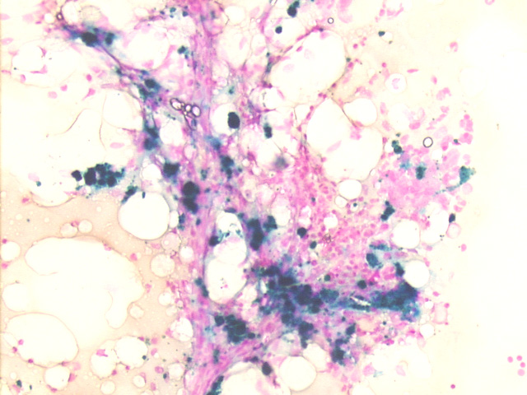
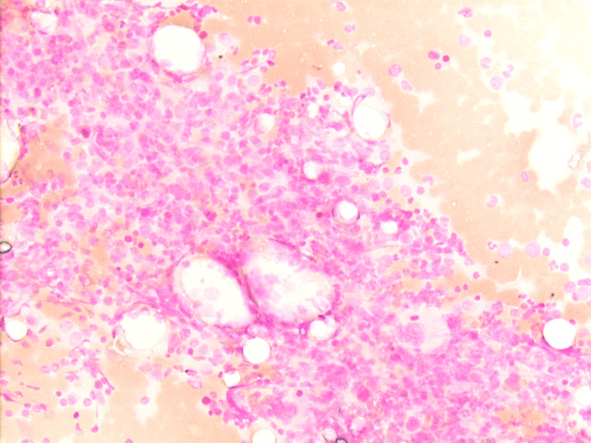
Anemia
Iron deficiency anemia (IDA)
Prussian Blue Stain of Bone Marrow
Iron Present
No Iron Present

Slide 14
Anemia
Megaloblastic anemia

Slide 15
Anemia
Megaloblastic anemia
It constitute a diverse group of entities, having in common impaired DNA synthesis and distinctive morphological changes in the blood and bone marrow.
As the name implies, the erythroid precursors and erythrocytes are abnormally large, thought to be related to defective cell maturation and division.
Major cause of megaloblastic anemia are folate and vitamin B12 deficiency
Folic acid (Vit. 9), Vit. B12 (cobalamine)

Slide 16
Anemia
Megaloblastic anemia
The normal proliferation of cells depends on adequate folate and vitamin B12.
Folate is necessary for efficient synthesis and production of DNA.
Vitamin B12 is needed to successfully incorporate circulating folic acid into developing RBCs; retaining the folate in the RBC.
Principle types of megaloblastic anemia:
Vitamin B12 deficiency anemia (pernicious anemia)
Folate deficiency anemia

Slide 17
Anemia
Megaloblastic anemia
Pernicious anemia:
Pernicious anemia (or - also known as Biermer's anemia, Addison's anemia, or Addison–Biermer anemia) is a form of megaloblastic anemia
The term 'pernicious anemia' is sometimes also incorrectly used to indicate megaloblastic anemia due to any cause of vitamin B12 deficiency.
The main cause is loss of ability to absorb vitamin B-12 .

Slide 18
Anemia
Megaloblastic anemia
Pernicious anemia:
Causes
Autoimmune destruction of gastric parietal cells that secrete intrinsic factor (glycoprotein). In the absence of IF, vitamin B12 cannot be absorbed.
Hereditary malabsorption of vitamin B12.
Partial or total gastrectomy-these individuals become intrinsic factor deficient.
Insufficient production of lF, occasionally seen in older people.
Dietary deficiency of B12, is seen among the strict vegetarians of low socioeconomic group in the developing countries. Only produce by microorganisms and not by animals and plants. Foods of animal origin are the only sources for vitamin B12 e.g., liver, kidney, milk, curd, eggs, fish, pork and chicken. Curd is a better source than milk, due to the synthesis of vit. B12 by Lactobacillus.

Slide 19
Anemia
Megaloblastic anemia
Pernicious anemia:
Symptoms
Many signs and symptoms are attributed to anemia: Fatigue, low blood pressure, rapid heart rate, pallor, and shortness of breath.
Neuropathic pain (neuronal degeneration and demyelination of nervous system)
Frequent diarrhea, vomiting, indigestion
Paresthesias, such as pins and needles sensations or numbness in fingers or toes, due to B12 deficiency affecting nerve function
Jaundice due to impaired formation of blood cells
Glossitis due to B-12 deficiency
May present with hyperthyroidism or hypothyroidism
Personality or memory changes

Slide 20
Anemia
Megaloblastic anemia
Pernicious anemia:
Lab Diagnosis:
A complete blood cell count (CBC). (High MCV and a normal MCHC is a characteristics)
Examination of a blood smear (peripheral smear) (macrocytic, normochromic is a characteristics)
Blood vitamin B-12 level measurements (Schilling test).
Tests for the presence of autoantibodies to intrinsic factor (carrier protein for vitamin B12) or stomach lining cell
Blood levels of iron and iron-binding capacity
Folate levels (which are often reduced when vitamin B-12 levels are low)
Finally, bone marrow aspiration or bone marrow biopsy may be recommended in some cases if bone marrow disorders are suspected.

Slide 21
Anemia
Megaloblastic anemia
Folic acid deficiency anemia:
It occurs when our body doesn’t get enough folic acid.
Folic acid is one of the vitamin B (vitamin B9) and it helps to make our body new cells including new red blood cells.
Folate deficiency occurs in people who rarely eat uncooked vegetables (green leafy vegetable).
Alcohol increases folic acid requirements; folic acid requirements are also increased in patients with chronic hemolytic anemia and in women who are pregnant.
Some patients with malabsorptive diseases of the small bowel may not absorb folic acid normally

Slide 22
Anemia
Megaloblastic anemia
Folic acid deficiency anemia:
Causes
Alcoholism
Deficient intake
Increased needs: pregnancy, infant, rapid cellular proliferation, and cirrhosis
Malabsorption (congenital and drug-induced)
Intestinal and jujenal resection
Deficient thiamine and factors (e.g., enzymes) responsible for folate metabolism.
Combined Deficiency : Vitamin B12 & folate.
Inherited DNA Synthesis Disorders
Some drugs and toxins (methotrexate, mercaptopurine, cytosine arabinoside, Phenytoin)
Notes:
Methotrexate & mercaptopurine= cancer, immune system; cytosine arabinoside= leukaemia; Phenytoin= anti-seizure

Slide 23
Anemia
Megaloblastic anemia
Folic acid deficiency anemia:
Clinical manifestation:
Fatigue, weakness, pallor, dizziness, headache, tachycardia
Sore tongue, cracked lips
Loss of appetite, weight loss, heart palpitation

Slide 24
Anemia
Megaloblastic anemia
Folic acid deficiency anemia:
Lab Diagnosis:
Decreased red blood cell (RBC) count and hemoglobin levels
Increased mean corpuscular volume (MCV) and mean corpuscular hemoglobin (MCH)
Normal mean corpuscular hemoglobin concentration (MCHC)
The reticulocyte count is decreased due to destruction of fragile and abnormal megaloblastic erythroid precursor.
The platelet count may be reduced.
Anisocytosis (increased variation in RBC size) and poikilocytosis (abnormally shaped RBCs).
Macrocytes (larger than normal RBCs) are present.
Ovalocytes (oval-shaped RBCs) are present.
High indirect bilirubin

Slide 25
Blood coagulation disorder

Slide 26
Blood coagulation disorder
Thrombocytopenia
Thrombocytopenia is defined as a reduction in the peripheral blood platelet count below the lower limit of normal i.e. below 150,000/μl.
Thrombocytopenia is associated with abnormal bleeding that includes spontaneous skin purpura and mucosal haemorrhages as well as prolonged bleeding after trauma.
Platelets are produced by the bone marrow. They are not whole cells, but are fragments of extraordinarily large bone marrow-bound megakaryocytes.
The hormone thrombopoietin (produced by liver) increases the number of megakaryocytes in the bone marrow, stimulating them to produce more platelets

Slide 27
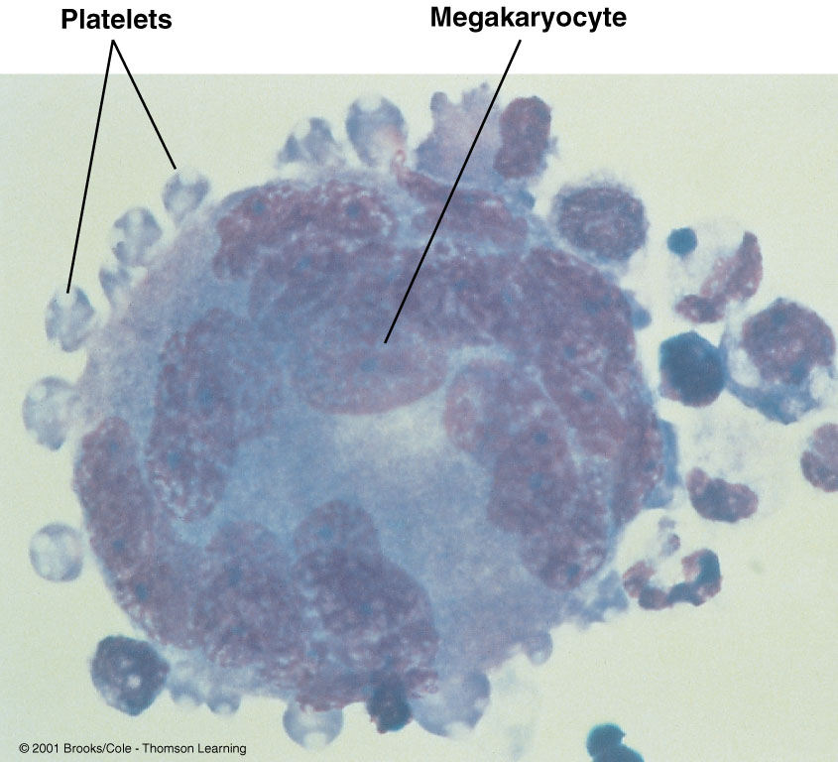
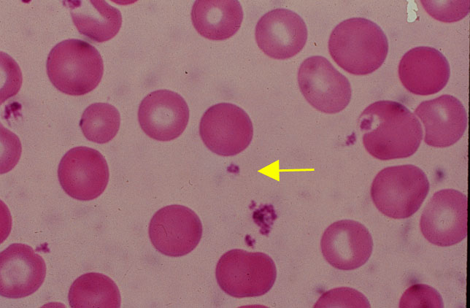
Blood coagulation disorder
Thrombocytopenia
* Cell fragments bound to megakaryocytes
* “Bud Off” and are released into the blood

Slide 28
Blood coagulation disorder
Thrombocytopenia
Causes/Etiology:
Thrombocytopenia may result from 4 main groups of causes:
Impaired platelet production. (BM failure & suppression by drugs)
Accelerated platelet destruction. (immune & excessive consumption)
Splenic sequestration. (splenomegaly)
Dilutional loss. (transfusion of old stored blood)

Slide 29
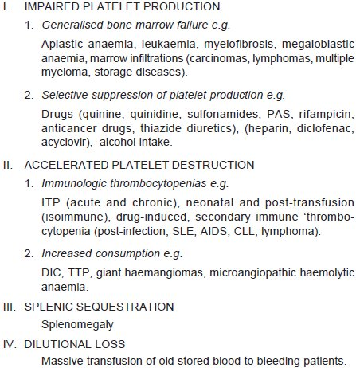
Blood coagulation disorder
Thrombocytopenia
Causes/Etiology:
Notes:
Immune/idiopathic Thrombocytopenic Purpura (ITP) Thrombotic Thrombocytopenic Purpura (TTP)

Slide 30
Blood coagulation disorder
Haemophilia

Slide 31
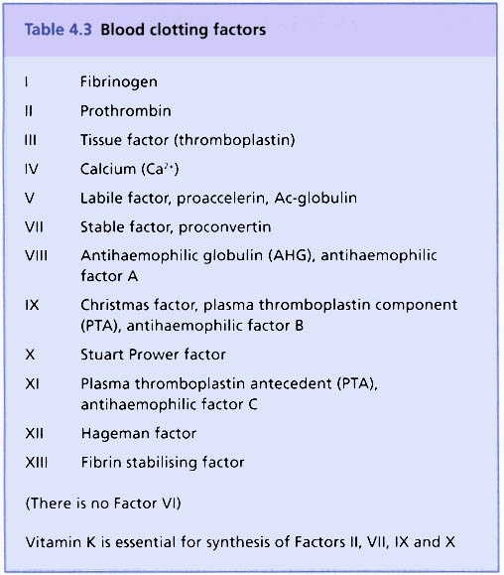
Blood coagulation disorder
Haemophilia
An inherited disorder of blood coagulation which results in prolonged bleeding even after minor injury.
Blood clotting factors
Deficiency of factor VIII (antihaemophilic globulin, antihaemophilic factor A), an essential clotting factor in the coagulation cascade – the complex series of biochemical events that leads from injury of the wall of a blood vessel to the formation of a blood clot that checks bleeding.

Slide 32
Blood coagulation disorder
Haemophilia
Types:
Haemophilia A:
In this disease, factor VIII is abnormal and is less biologically active. The disorder is inherited as a sex-(X-) linked recessive trait and, therefore, manifests clinically in males, while females are usually the carriers.
Haemophilia B (Christmas disease):
This is the less common sex-linked genetic haemorrhagic disease. Factor IX (Christmas factor/ antihaemophilic factor B) is deficient, resulting in deficiency of thromboplastin (clotting factor III)

Slide 33
Blood coagulation disorder
Haemophilia
Clinical features:
Patients of haemophilia suffer from bleeding for hours or days after the injury.
The clinical severity of the disease correlates well with plasma level of factor VIII activity.
Haemophilic bleeding can involve any organ but occurs most commonly as recurrent painful haemarthroses (bleeding and fibrosis at joints) and muscle haematomas (collection of blood forming a definite swelling), and sometimes as haematuria (blood in urine).
Spontaneous intracranial haemorrhage and oropharyngeal bleeding are rare, but when they occur they are the most feared complications.

Slide 34
Blood coagulation disorder
Haemophilia
Laboratory features:
The following tests are abnormal:
Whole blood coagulation time is prolonged in severe cases only.
Prothrombin time (PT) is usually normal.
Activated partial thromboplastin time (APTT) is typically prolonged.
Specific assay for factor VIII shows lowered activity.

Slide 35
Lymphoreticular System

Slide 36
Lymphoreticular System
Lymph:
Fluid which circulates in the lymphatic vessels of the body.
Colourless fluid, like blood plasma in composition, only rather more watery.
Contains salts similar to those of blood plasma, and the same proteins, although in smaller amount: fibrinogen, serum albumin, and serum globulin.
Contains lymphocytes (white blood cells), derived from the glands.

Slide 37
Lymphoreticular System
Lymph:
In some lymphatic vessels, the lymph contains, after meals, a great amount of fat in the form of a fine milky emulsion.
These are the vessels which absorb fat from the food passing down the intestine, and convey it to the thoracic duct; they are called lacteals because their contents look milky (chyle).
The lymph is derived, initially, from the blood, the watery constituents of which exude through the walls of the capillaries into the tissues, conveying material for the nourishment of the tissues and absorbing waste products.

Slide 38
Lymphoreticular System
Lymph Nodes:
Bean-shaped or oval structures varying in length from 1 to 2 cm and form the part of lymphatic network distributed throughout the body.
Consist of a cortex, medulla and lymph sinuses and have two main functions: (1) the interception and removal of abnormal or foreign material from the lymph; (2) the production of immune responses (immunity).
Become enlarged when the area of the body which they drain is the site of infection or as a manifestation of some systemic diseases.
Occasionally they are the site of primary or metastatic malignant disease.

Slide 39
Lymphoreticular System
Lymphadenitis:
Reactive Lymphadenitis
Lymph nodes undergo reactive changes in response to a wide variety of stimuli which include microbial infections, drugs, environmental pollutants, tissue injury, immune-complexes and malignant neoplasms.
However, the most common causes of lymph node enlargement are inflammatory and immune reactions, aside from primary malignant neoplasms and metastatic tumour deposits.
primary inflammatory reaction reactive lymphadenitis, primary immune reactions lymphadenopathy.

Slide 40
Lymphoreticular System
Lymphadenitis:
Acute lymphadenitis, caused by microbes transported in lymph from other areas of infection.
The nodes become inflamed, enlarged and congested with blood, and chemotaxis attracts large numbers of phagocytes.
If lymph node defences (phagocytes and antibody production) are overwhelmed, the infection may cause abscess formation within the node.
Adjacent tissues may become involved, and infected materials may be transported through other nodes and into the blood.

Slide 41
Lymphoreticular System
Lymphadenitis:
Acutely inflamed nodes are enlarged, tender, and if extensively involved, may be fluctuant.
The overlying skin is red and hot.
After control of infection, majority of cases heal completely without leaving any scar.
If the inflammation does not subside, acute lymphadenitis changes into chronic lymphadenitis.

Slide 42
Lymphoreticular System
Lymphadenitis:
Morphologic features:
Grossly, the affected lymph nodes are enlarged 2-3 times their normal size and may show abscess formation if the involvement is extensive.
Microscopically, the sinusoids are congested, widely dilated and edematous and contain numerous neutrophils.
The lymphoid follicles are prominent with presence of many mitoses and phagocytosis.
In more severe cases, necrosis may occur and neutrophil abscesses may form.

Slide 43
Lymphoreticular System
Lymphadenitis:
Chronic nonspecific lymphadenitis, commonly called reactive lymphoid hyperplasia, is a common form of inflammatory reaction of draining lymph nodes as a response to antigenic stimuli such as repeated attacks of acute lymphadenitis and lymph from malignant tumours.
Depending upon the pattern in chronic nonspecific lymphadenitis, three types are distinguished, each having its own set of causes.
follicular hyperplasia,
paracortical hyperplasia,
sinus histiocytosis or hyperplasia.

Slide 44
Lymphoreticular System
i. Follicular hyperplasia
Marked enlargement and prominence of the germinal centres of lymphoid follicles (proliferation of B-cell areas) due to the presence of numerous mitotically active lymphocytes and proliferation of phagocytic cells containing phagocytosed material.
Parafollicular and medullary regions are more cellular and contain plasma cells, histiocytes, and some neutrophils and eosinophils.
There is hyperplasia of mononuclear phagocytic cells lining the lymphatic sinuses in the lymph node.

Slide 45
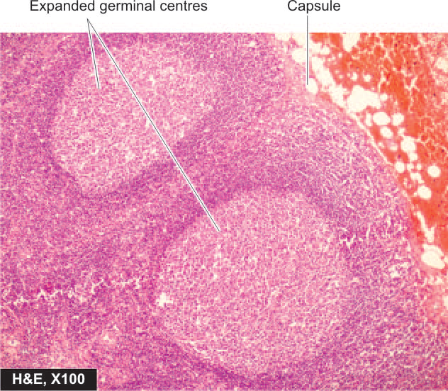
Lymphoreticular System
Fig: Reactive lymphadenitis, follicular hyperplasia type.

Slide 46
Lymphoreticular System
ii. Paracortical lymphoid hyperplasia
It is due to hyperplasia of T-cell-dependent area of the lymph node. Amongst the important causes are immunologic reactions caused by drugs, vaccination, and autoimmune disorders.
There is expansion of the paracortex (T-cell area) with increased number of T-cell transformed immunoblasts.
iii. Sinus histiocytosis or sinus hyperplasia
Expansion of the sinuses by proliferating large histiocytes containing phagocytosed material.

Slide 47
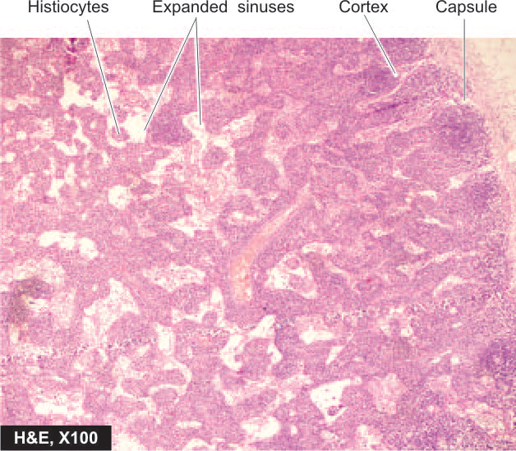
Lymphoreticular System
Fig: Reactive lymphadenitis, sinus histiocytosis type.

Slide 48
Lymphoreticular System
Lymphoma

Slide 49
Lymphoreticular System
Lymphoma:
Cancer of lymph node
A malignant tumour of the lymph nodes divided histologically and clinically into two types: Hodgkin’s disease, and non-Hodgkin’s lymphoma.
Hodgkin’s disease or lymphadenoma was named after Thomas Hodgkin (1798–1866), a pathologist, who first described the condition.
i. Hodgkin's disease
In this disease there is progressive, painless enlargement of lymph nodes throughout the body, as lymphoid tissue within them proliferates.
The superficial lymph nodes in the neck are often the first to be noticed.
The disease is malignant and the cause is unknown.
The disease spreads to adjacent nodes and to other tissues (spleen, liver, BM, bones) in a consistent way.

Slide 50
Lymphoreticular System
Lymphoma:
The disease leads to reduced immunity, because lymphocyte function is depressed, and recurrent infection is therefore common.
As lymph nodes enlarge, they may compress adjacent tissues and organs.
Anaemia and changes in leukocyte numbers occur if the bone marrow is involved.
The disease is characterised histologically by the presence of large malignant binucleate lymphoid cells (Reed-Sternberg cells) in the lymph glands.
Treatment is either with radiotherapy, chemotherapy or both, depending on when the disease is diagnosed and the nature of the abnormal lymph cells.
Cure rates are good, especially if the lymphoma is diagnosed early.

Slide 51
Lymphoreticular System
ii. Non-Hodgkin’s lymphoma
This varies in its malignancy depending on the nature and activity of the abnormal lymph cells.
Causative factor: viral, bacterial infections, genetic and immunological factors
High- and low-grade categories are recognised according to the rate of proliferation of abnormal lymph cells.
Low-grade tumours consist of well-differentiated cells and slow progress of the disease, death occurring after a period of years.
High-grade lymphomas consist of poorly differentiated cells and rapid progress of the disease, death occurring in weeks or months.

Slide 52
Lymphoreticular System
Hodgkin Lymphoma | Non-Hodgkin Lymphoma
Less common | More common
More often localized to a single axial group of nodes (cervical, mediastinal) | More frequent involvement of multiple peripheral nodes
Spread by contiguity | Noncontiguous spread
Mesenteric nodes and Waldeyer ring rarely involved | Mesenteric nodes and Waldeyer ring commonly involved
Extra-nodal involvement uncommon | Extra-nodal involvement common
Characterized by Reed-Sternberg cells | Majority involves B-cells; a few are of T-cell lineage
Burkitt’s lymphoma (mostly found in children in Africa) is a rapidly growing malignant tumour occurring in varying sites, and the Epstein Barr virus has a role in its origin and growth. May occur in lymphoid tissue and bone marrow.

Slide 54
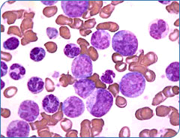
Leukaemia

Slide 55
Leukaemia
Leukemia is a malignant disease characterized by an abnormal and excessive proliferation of white blood cell precursors, blocked in a differentiation rate, and invading the whole bone marrow.

Slide 56
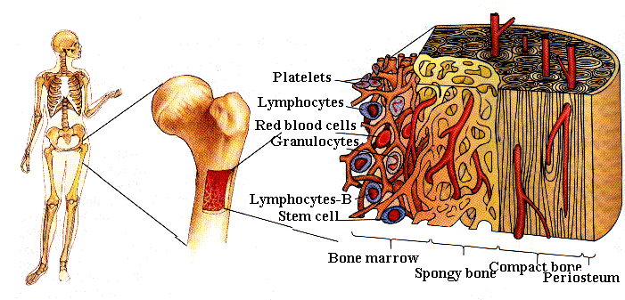
Leukaemia
Means “white blood” in Greek
Discovered by Dr. Alfred Velpeau in France, 1827
Named by pathologist Rudolf Virchow in Germany, 1845

Slide 57
Causes
Leukaemia
High level radiation/toxin exposure
Viruses
Genes
Chemicals
Mostly unknown

Slide 58
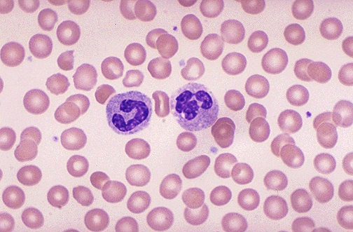
Pictures Of Blood
Leukaemia
Platelet
Platelet
White Cell
Red Cell
Red Cell
Blasts
White Cell
Normal human blood
Blood with leukemia
Sources from Arginine.umdnj.edu
Sources from beyond2000.com

Slide 59
Development of Leukemia in the Bloodstream
Stage 1- Normal
Stage 2- Symptoms
Stage 3- Diagnosis
Legend
White Cell
Stage 5a- Anemia
Red Cell
Platelet
Blast
Stage 4- Worsening
Germ
Stage 5b- Infection
Sources from Leukemia, by D. Newton and D. Siegel

Slide 60
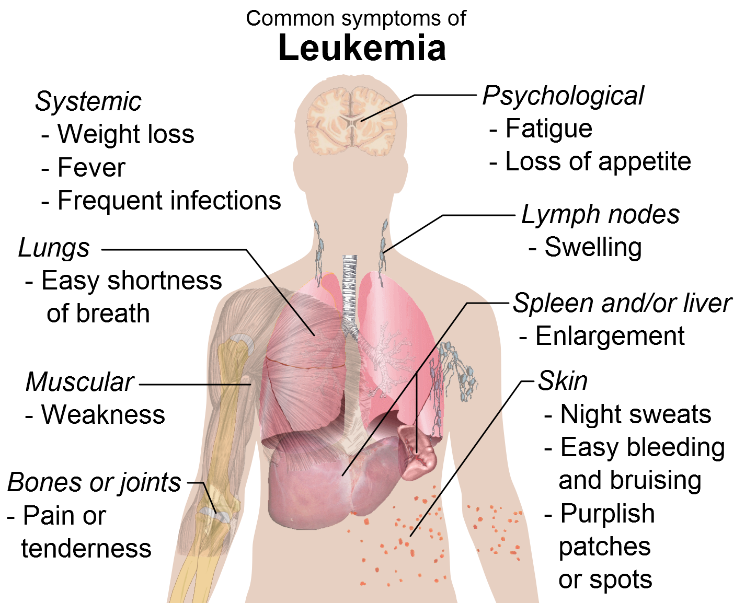
Clinical features of acute leukemia
Due to organ infiltration
Bone pain
Lymphadenopathy or hepatosplenomegaly
Bone marrow failure
Anemia – dyspnea, fatigue, palpitations
Neutropenia – fever, infections
Thrombocytopenia – bleeding from skin or mucosa
Hypermetabolic state
Fever
Drenching night sweats

Slide 61
Effects On the Body
Leukaemia
Attacks the immune system
Infections
Anemia
Weakness
No more regular white blood cells, red blood cells, and platelets
Blasts affects the blood stream and bone marrow

Slide 62
Types of Leukemia
Acute
Rapid growth of immature
blood cells
Mostly in children,
young adults
Needs immediate treatment
Chronic
Excessive build up of
mature blood cells
Mostly in older patients
Monitoring before treatment
Hence we have;
i. Acute Lymphocytic/Lymphoblastic Leukemia(ALL) :
most common type in young children;
also affects adults, > 65
ii. Acute Myelogenous/ Myeloid Leukemia(AML):
more commonly in adults than in children.
iii. Chronic Lymphocytic leukemia (CLL):
most often affects adults over the age of 55
iv. Chronic Myelogenous leukemia (CML):
occurs mainly in adults
Lymphoid
Affects lymphocytes and
plasma cells
Lymphocytic leukemia
Myeloid
Affects eosinophils,
neutrophils, basophils
Myelogenous leukemia

Slide 63
Leukaemia
acute
chronic
HCT
WBC
N
Plt
N

Slide 64
AML-Acute Myeloid Leukemia.
Adults common
Anemia, Fever, Bleeding
Hepatosplenomegaly moderate
No significant lymphadenopathy
Classification - M0 to M7.

Slide 65
Classification of AML is based on the degree of differentiation or maturation of the neoplastic cells
M0: AML with minimal differentiation not recognizable by
morphology
M1: AML with no maturation of >90% of myeloid blasts
M2: AML with maturation : Auer rods and primary granules visible
M3: APL (promyelocytic maturation)
M4: Acute Myelomonocytic leukemia
M5: Acute Monocytic leukemia
M6: Erythroleukemia
M7: Acute Megakaryocytic leukemia

Slide 66
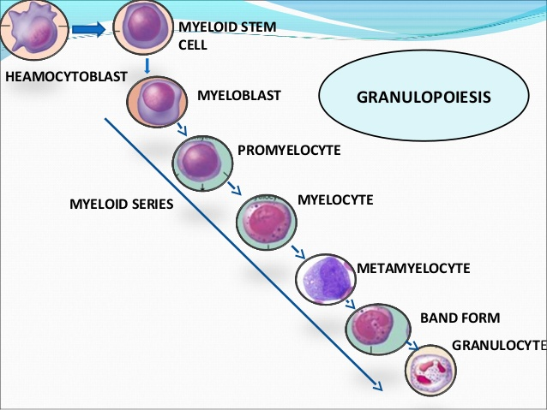
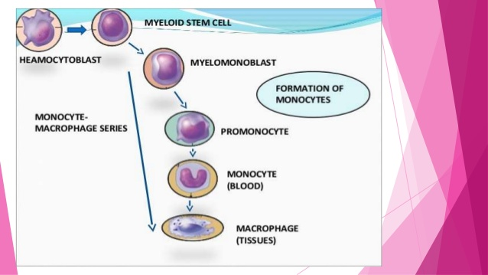
Fig: Leukopoiesis

Slide 67
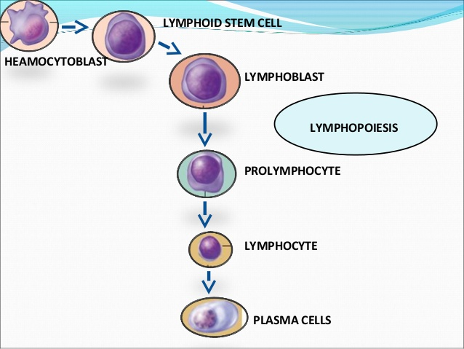
Fig: Leukopoiesis

Slide 68
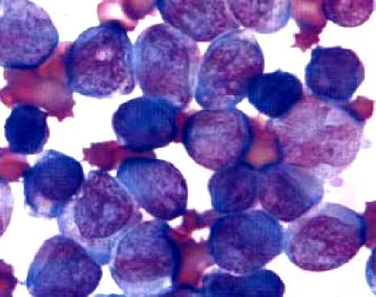
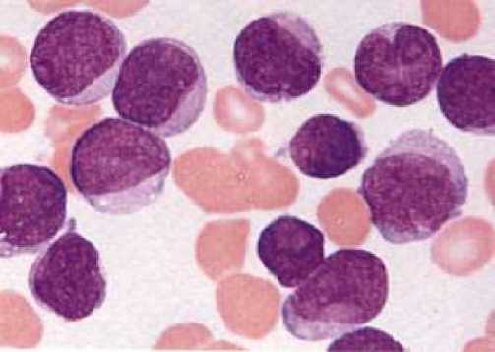
RBC
Blast cells

Slide 69
ALL-Acute Lymphocytic Leukemia.
Common in Children.
Classification L1, L2 & L3
Growth failure, Fever, Anemia, Lymphadenopathy, bleeding.
Moderate Hepatosplenomegaly

Slide 70
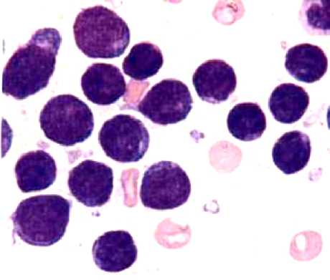
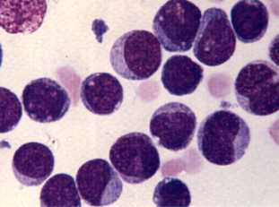
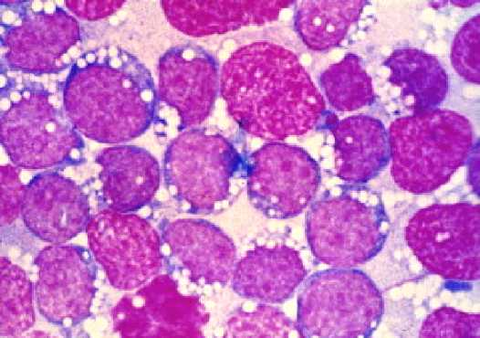
Classification of ALL may be based on morphology
Morphologic classification
L1: Blasts are homogenous, small, with scant nucleoli
L2 : Blasts are larger, heterogeneous with prominent nucleoli
L3: Blasts are large with basophilic cytoplasm and cytoplasmic vacuoles
ALL-L1
ALL-L2
ALL-L3

Slide 71
Acute Leukemia
Lab. Diagnosis
Normochromic Normocytic anemia
Decreased Platelet count
Prolonged bleeding time, Poor clot retraction time
Increased WBC count 50,000-1,00,000 per cumm.
Presence of immature and blast cells in peripheral blood
At least 30% blasts in bone marrow aspirate
AML and ALL are differentiated by morphological appearance
Cytochemical stains – myeloperoxidase +ve for AML and PAS+ve for ALL

Slide 72
Chronic Myeloid Leukemia
Middle age 40-60 yrs
Anemia, Fever & Bleeding
Marked leucocytosis - >50,000 (abnormal)
Marked splenomegaly, Hepatomegaly
Hematological features:
Leucocytosis
Increased myelocyte and mature neutrophil
Eosinophilia and basophilia

Slide 73
Chronic Myeloid Leukemia
Natural Evolution of CML
Chronic phase: usually presents in this phase, with progressive leucocytosis and splenomegaly.
Accelerated phase: Symptoms are worse, with night sweats, bone pain, splenomegaly, less responsive to therapy. Peripheral blood shows increasing numbers of basophilic, blasts and promyelocytes. Disease is difficult to control.
Blastic phase: symptoms progress, extramedullary deposits (chloromas; greenish growths appear under the skin or green cancer) appear, > 30% blasts in blood or bone marrow.
Blast transformation may be lymphoid (15%) or myeloid (85%)

Slide 74
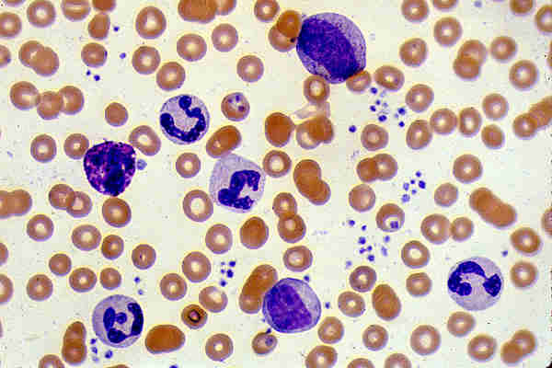
Chronic Myeloid Leukemia

Slide 75
Chronic Lymphocytic Leukemia
Elderly age
Anemia, fever & bleeding – slow over years.
Lymphocytosis & Lymphadenopathy
Spleen, & liver enlargement

Slide 76
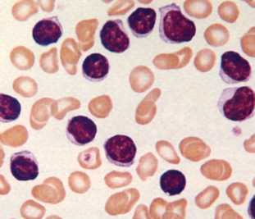
CLL – Blood Film

Slide 77
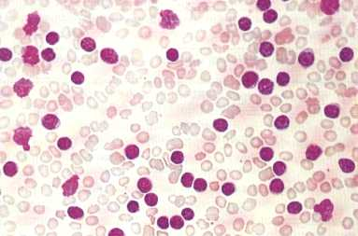
CLL – Blood Film

Slide 78
Treatment
Chemotherapy
Immunotherapy
Radiation
Bone marrow transplant

Slide 79
End of Unit…
Thank you for your kind attention…!!!

